Slide 1


Development Tool:
Python, Colab, Jupyter, Anaconda, PyCharm, VirtualEnv
Version: 13012024

Slide 2
Python

Slide 3

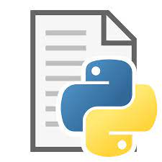
Not every program has a graphical user interface
Allow user to use mouse and keyboard to input
Needs a GUI
Run logic as instructed in the python script
No need a GUI

Slide 4
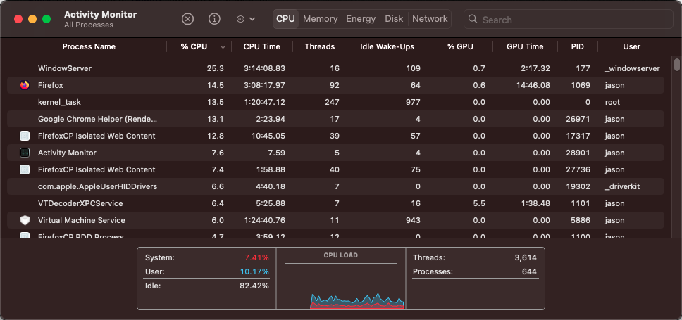
A lot of programs run without GUI

Slide 5
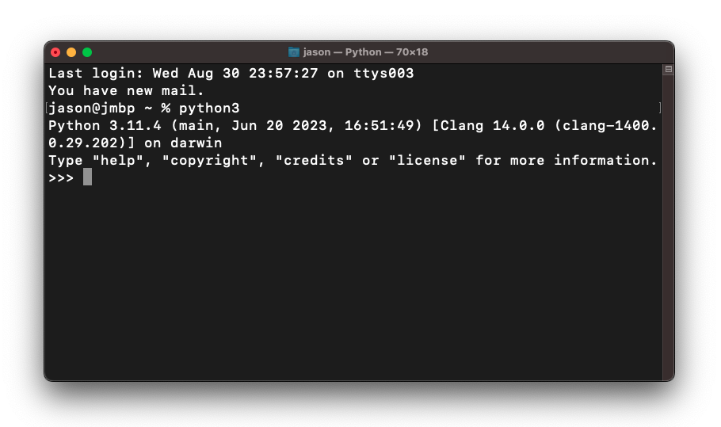
Python has no GUI
Programs without a GUI run in a terminal. Some can even run in the background without terminal.
In Mac - Terminal
In Windows - CMD or Powershell

Slide 6
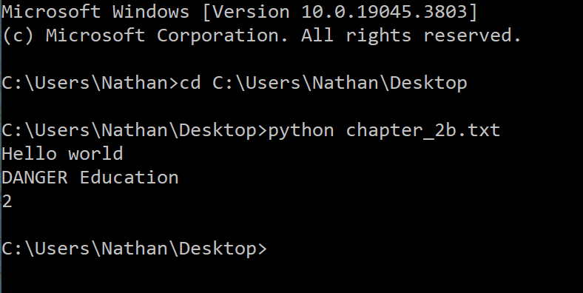
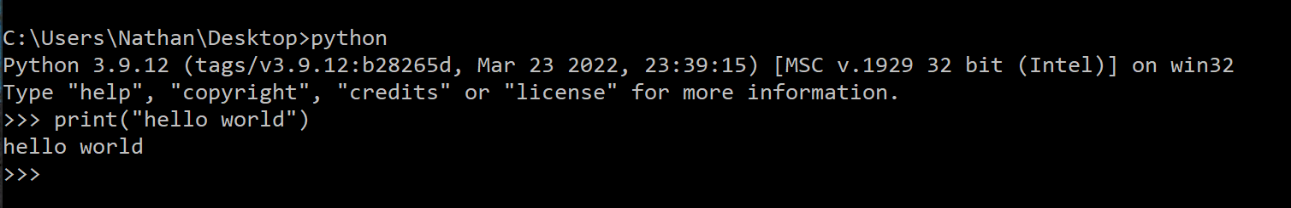
How to run python in terminal?
Start the python interpreter, then enter python code line by line
Type "python" or "python3"
Start the python interpreter with a path to python code, then the interpreter will execute the code in the file line by line.
Type "python \path\to\file" or "python3 \path\to\file"
Example:
‘python’:
It means you want to run the txt in the python interpreter

Slide 7
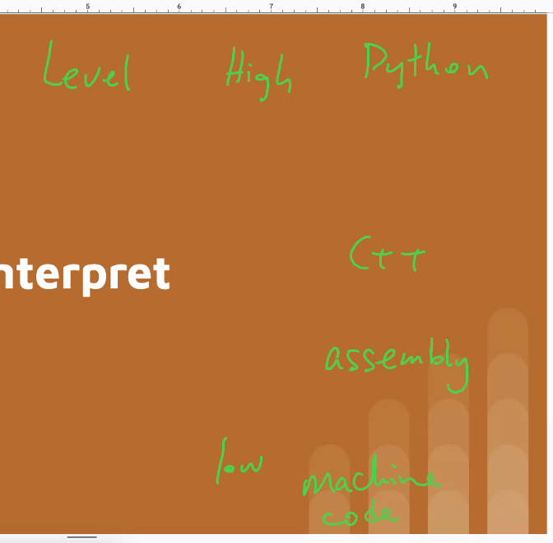
Compile vs Interpret
Compiler programme:
Turn C,C++ -→ to machine codes
Build one or windows, linus/ intel or arm chips?
We have to build different machine codes
Windows you can see .exe but in linux u don’t see this
Python JS R are interpreted language already
Original interpreter is C-code
Interpreter does not require compilation
It is not the real programme. The real programme is lke python interpreter. This is compiled already
The python interpreter needs to compile different version: Windows/ Linux
Though different version, they work in the same way. Intepreter read whay I’m saying

Slide 8
Compiled Program
C
C++
GoLang
Our
Code
Executable
Compile
Whenever code is changed
Machine (CPU, OS) dependent

Slide 9
Interpreted Program
Our
Code
Python
Javascript
R
Pass as string for input
Code
(Premade)
python.exe
Compile

Slide 10
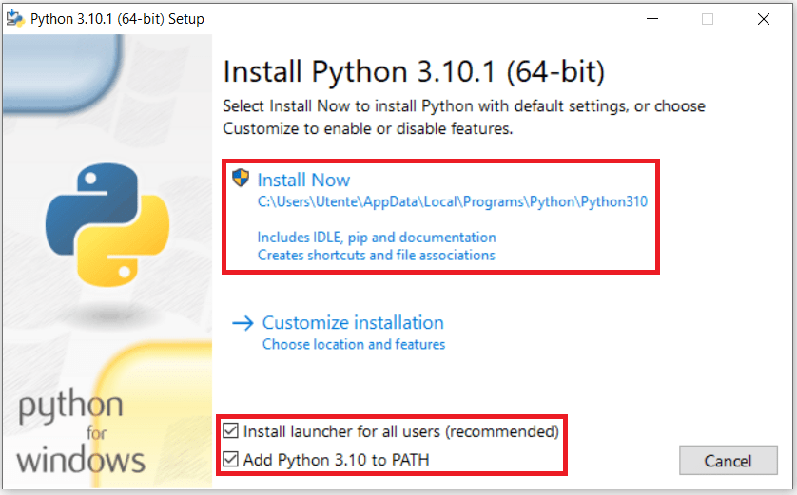
Install Python Interpreter (before you can run python code on your computer)
https://www.python.org/downloads/

Slide 11
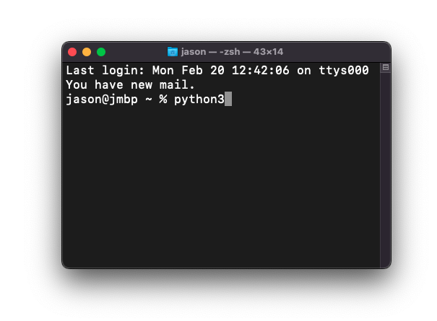
(Optional) What is PATH?
The PATH variable is a list of paths for the shell to look for executable to run, it looks like the following.
/usr/bin:/usr/local/bin/………
E.g. When we type python3:
The shell will check these paths sequentially:
/usr/bin
/usr/local/bin/
…
When we “Add python to PATH”, we essentially append the folder which contains the python executable to the path variable.

Slide 12
“Python”
The word “python” is generally referred to as the python language.
We call the interpreter as “Python Interpreter”
“Python interpreter” is an executable, but a python file is not.
A python file is a plain text file (no difference from a .txt file).
Checkpoint
Can we put all python code in a txt file, then ask the python interpreter to run that txt?
Notes:
Yes. Since file extension does not modify the file itself, it makes no difference for the python interpreter to read between a .py file and a .txt file.

Slide 13
Virtual environment

Slide 14
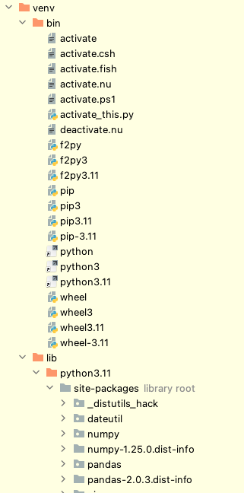
Virtual environment
An isolated replica of your python interpreter.
Self containing in a single folder
Contain installed packages
Is derived from a base interpreter
The folder structure of the venv folder. The content is slightly different between mac version and windows version.

Slide 15
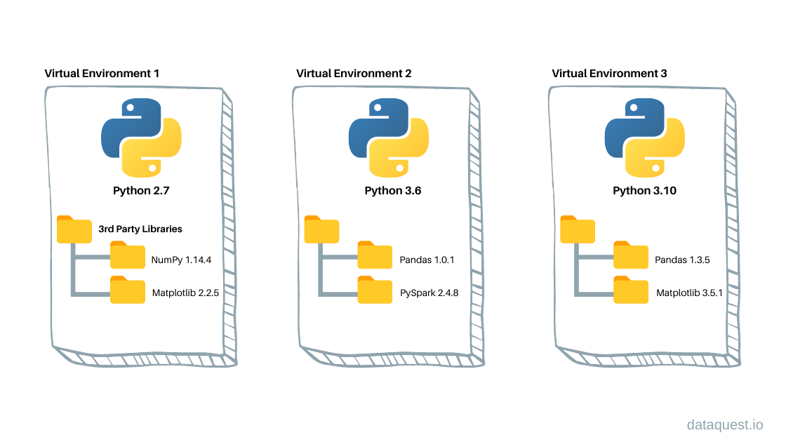
Create a venv
virtualenv package (Python native)
Pipenv
Poetry
Anaconda (Popular for data science)

Slide 16

Native venv vs Anaconda
Recommend to use git to change code btw ☺
 | Native venv | Anaconda
Pre-installed package | None | A lot
How many environments? | Usually one per project | Usually one per machine
Intended usage | Software development E.g. Web scraping task | Data science, analytics
Recommended? | Yes | Only when you seldom need to update the virtual environment

Slide 17
IDE

Slide 18
Reminder
Python has no GUI
Python has no GUI
Python has no GUI

Slide 19
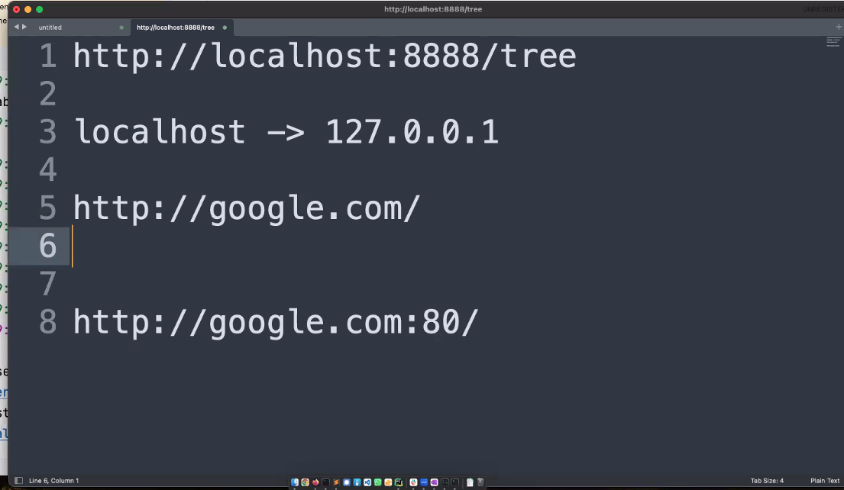
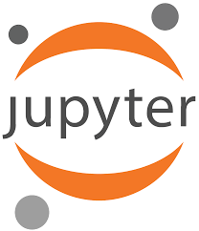
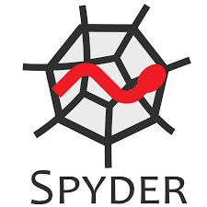

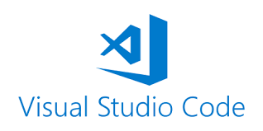
Integrated development environment
This “environment” has NOTHING to do with the python virtual environment.
It refers to the tool that help us develop python applications.
TCP protocol
telnet is a programme (helps us to connect to other machines with TCP connection.)

Slide 20
Checkpoint
What’s wrong with the following statements?
PyCharm executes my python scripts
Running python code in jupyter notebook does not require a python interpreter
Notes:
No, PyCharm does not execute python scripts, but the python interpreter executes.
No, jupyter is backed by a python interpreter

